Slide 1
Boosting Algorithm in Machine Learning
Simple Guide: AdaBoost, XGBoost, LightGBM

Slide 2
What is Boosting?
Boosting = Combining many weak models into one strong model.
Trains models step by step (sequentially).
Each new model fixes mistakes of the previous one.
Bagging trains in parallel, Boosting trains in sequence.
Good: reduces bias, strong predictions.
Caution: can overfit, sensitive to noisy data.

Slide 3
AdaBoost (Adaptive Boosting)
Idea: Misclassified points get more focus in the next round.
Start: equal weight for all samples.
Misclassified points → weight increases.
Next model learns from these difficult points.
Final result = weighted vote of all models.
Good for simple problems, but sensitive to noise.

Slide 4
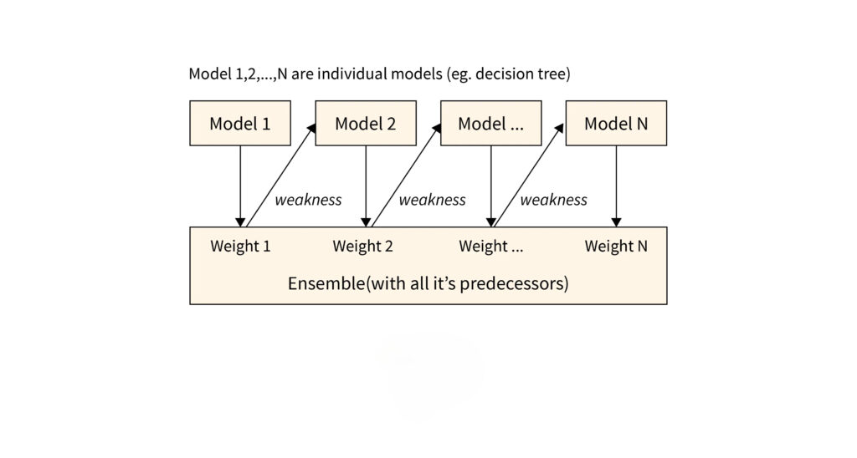
Pictorial view of Ada Boosting

Slide 5
XGBoost (Extreme Gradient Boosting)
Advanced form of Gradient Boosting.
Adds regularization (reduces overfitting).
Faster with parallel computing.
Handles missing values well.
Very popular for big data tasks.

Slide 6
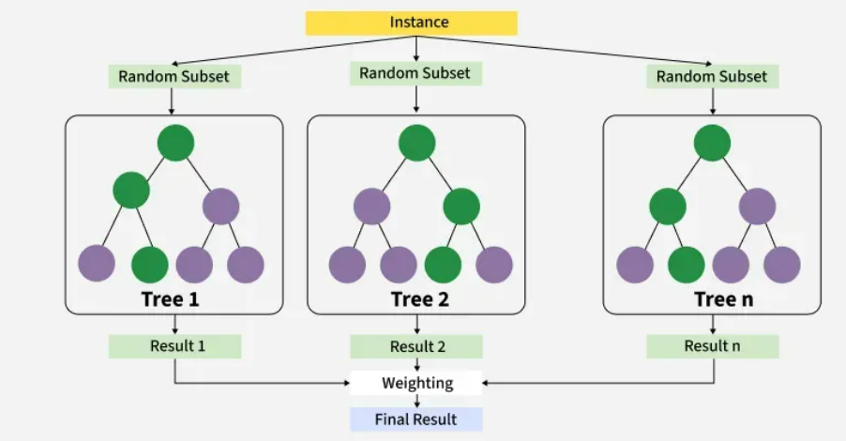
How XGBoost Works? It builds decision trees sequentially with each tree attempting to correct the mistakes made by the previous one. The process can be broken down as follows: Start with a base learner: The first model decision tree is trained on the data. In regression tasks this base model simply predicts the average of the target variable. Calculate the errors: After training the first tree the errors between the predicted and actual values are calculated. Train the next tree: The next tree is trained on the errors of the previous tree. This step attempts to correct the errors made by the first tree. Repeat the process: This process continues with each new tree trying to correct the errors of the previous trees until a stopping criterion is met. Combine the predictions: The final prediction is the sum of the predictions from all the trees.

Slide 7
LightGBM (Light Gradient Boosting Machine)
Designed for speed and efficiency.
Leaf-wise tree growth (more accurate but may overfit).
GOSS: ignores small gradient data to speed up.
EFB: reduces data size by bundling features.
Best for very large datasets, faster than XGBoost.

Slide 8
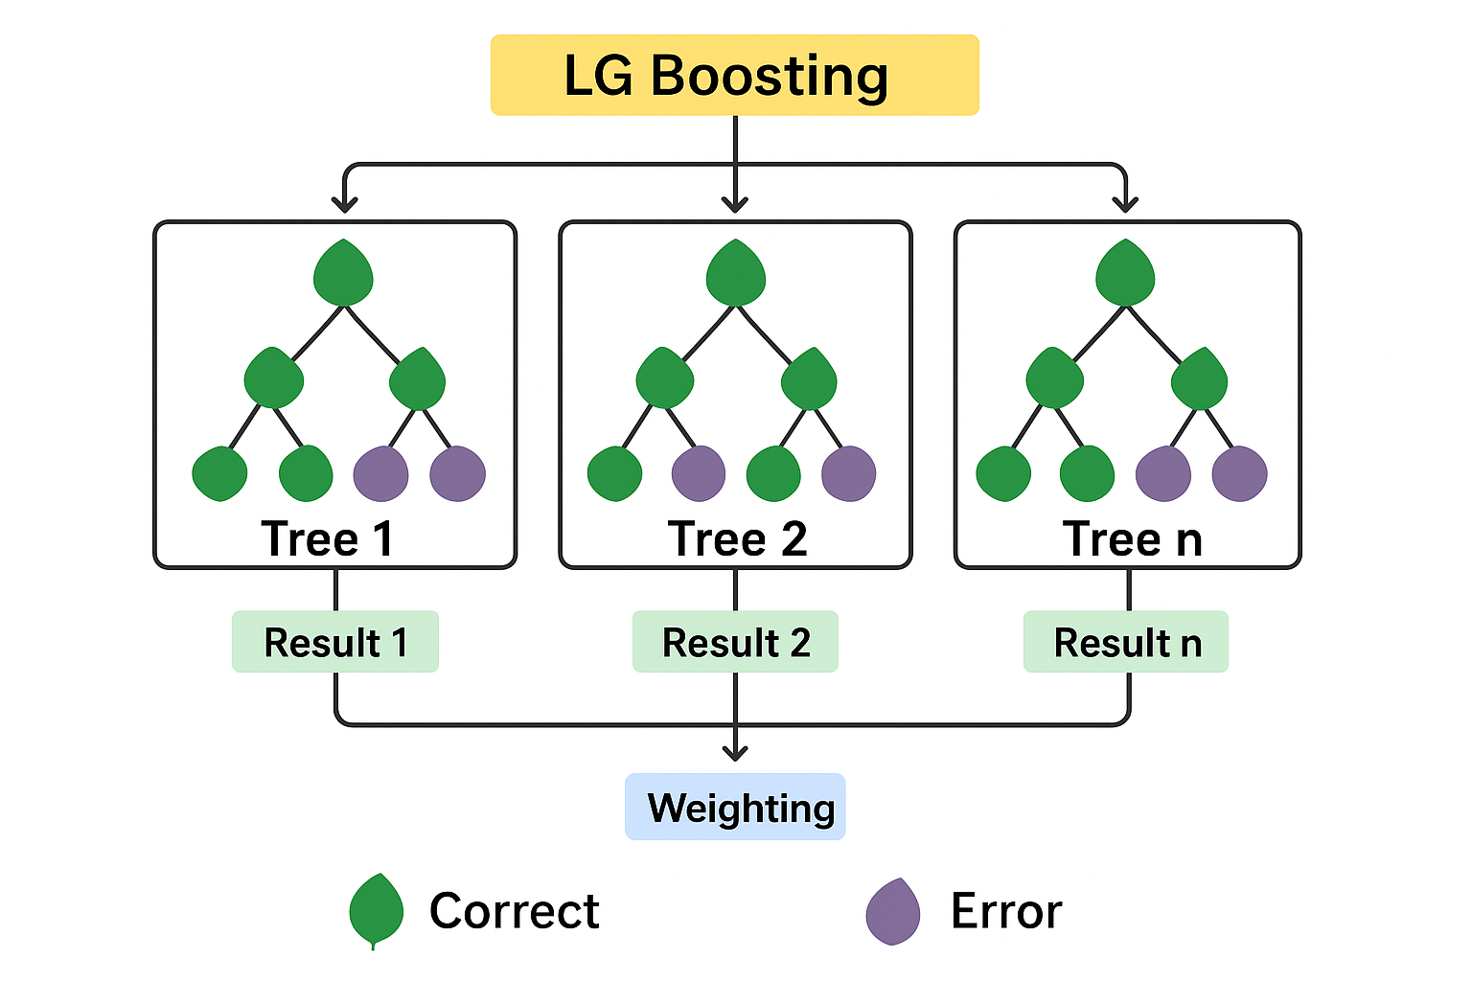

Slide 9
Summary
Boosting = small models combined into strong one.
AdaBoost → Simple, good for small tasks.
XGBoost → Accurate, scalable, widely used.
LightGBM → Very fast, great for big data.
Choose based on data size & speed needs.

